Slide 1
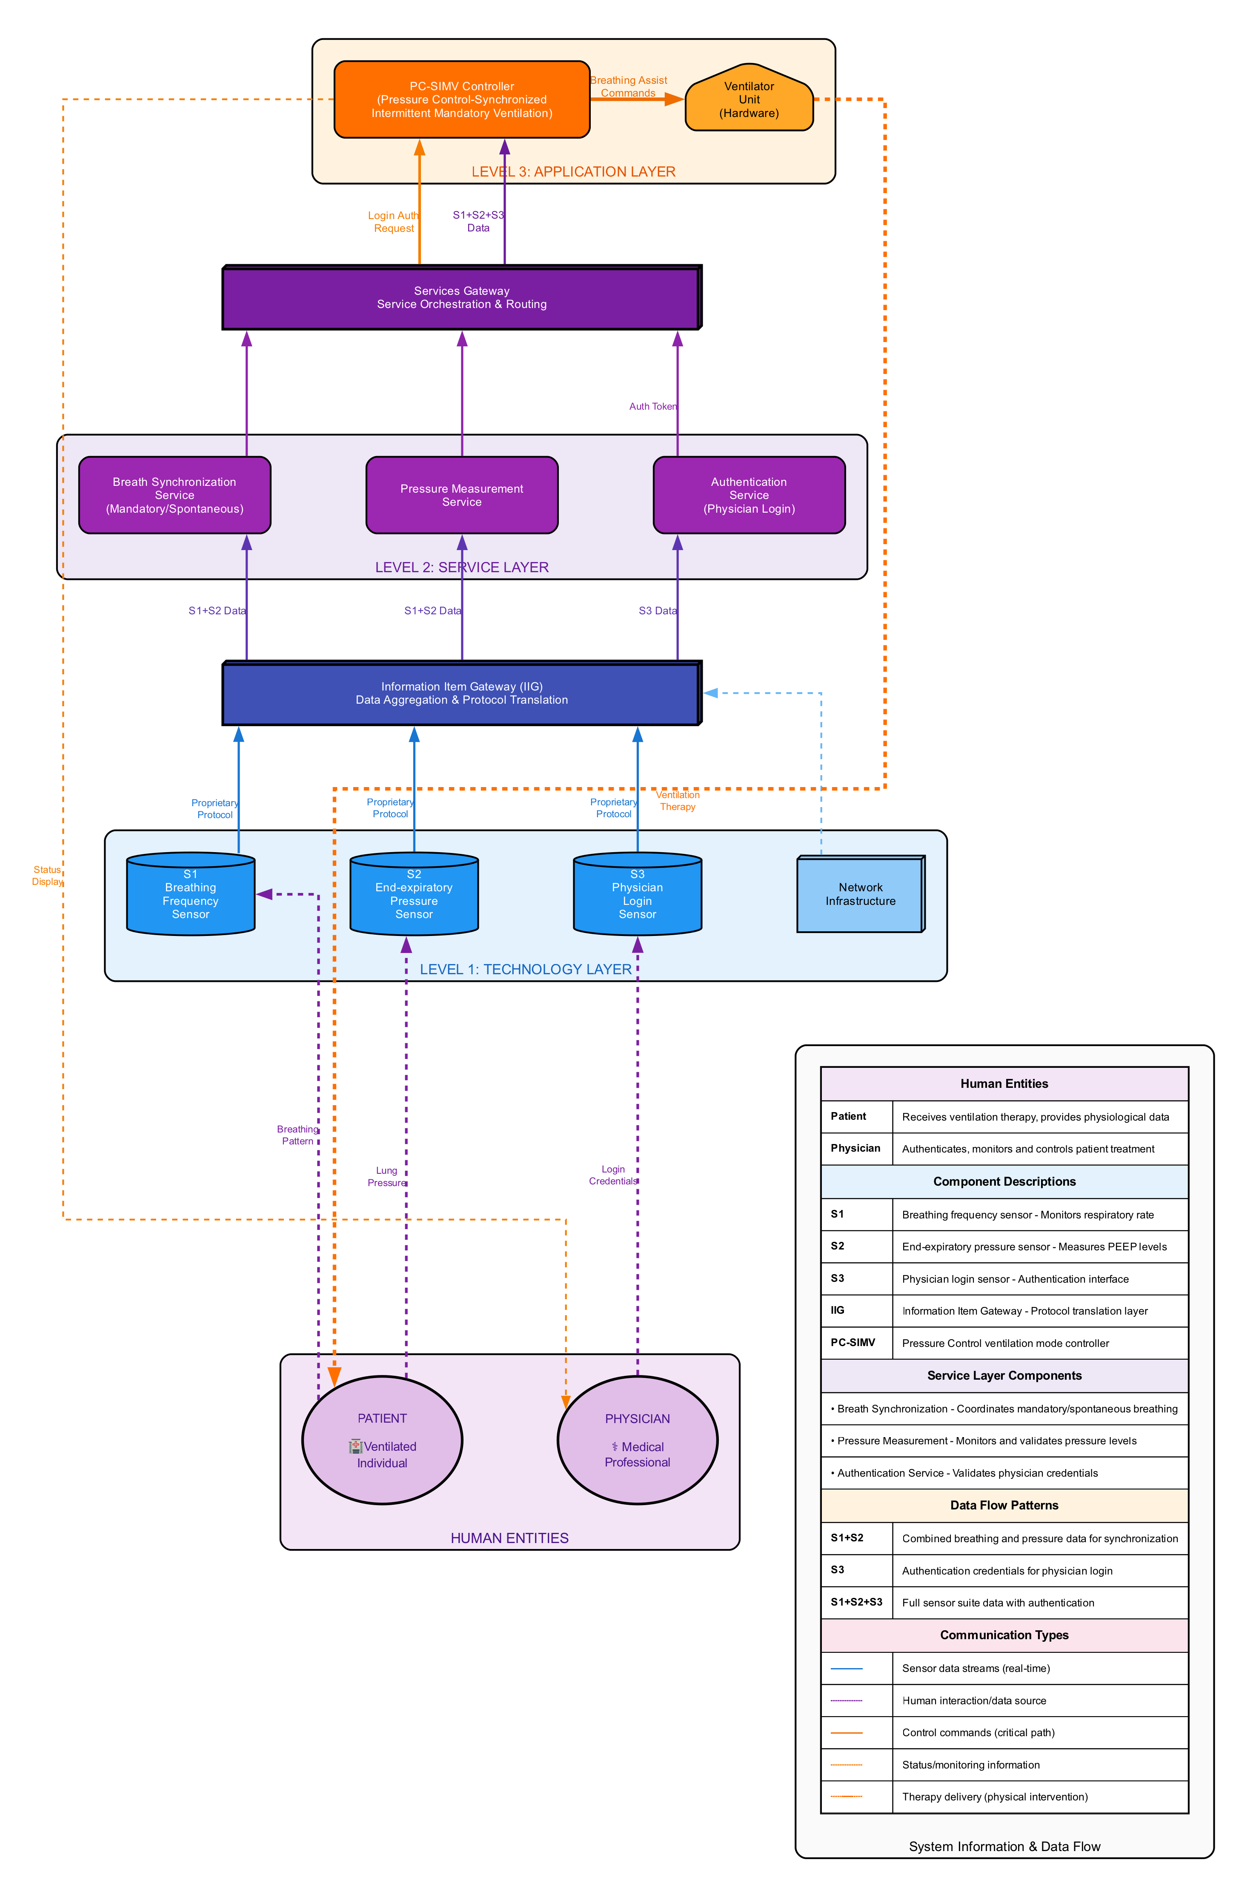
Parse
Create a Workflow ()
  [A] Grab a characteristic (confidentiality, human trust ..)
  [B] Grab information item ( breathing pattern – lung pressure, credentials )
  [C] Chose information state for one of these information items ( for example “Transmission is the information state of “breathing pressure” information item, captured while being transmitted from sensor to gateway ” )
  [D] Write a requirement that protects that information item in the chosen information state relative to the chosen characteristic.
  [E] Generate a report.
  [A] choosing the confidentiality characteristic for [B] the information item (breathing pattern) in the information state [C] storage and write a
  [D] requirement for it to be encrypted in 128 bit encryption [now it’s completely specified] and generate a [E] report that has one record.
Input

